Slide 1





International University - VNU HCMC
Final Project - (2024 - 2025 Semester 01)
IT069IU - Object-Oriented Programming
Tetris Game
Presented by: DNAT Group

Slide 2
About our group
Le Vo Hong Na - ITITSB23007
Pham Quang Tuong - ITDSIU20108
Nguyen Nhat Anh - ITITSB23006
Nguyen Nhat Duy - ITITWE22143

Slide 3
Presentation Structure
Introduction
What is Tetris game
UML diagrams
Tetris Objects
How to play the game

Slide 4
Introduction
This is our OOP final project - a Tetris game
This project demonstrates key OOP principles that we have learned in this OOP course like encapsulation, inheritance, and polymorphism.

Slide 5
What is Tetris game
Tetris game, which was created in 1984 by Alexey Pajitnov, is a classic puzzle game genre associated with many generations.
When a line is successfully formed, it disappears, and the player earns points. As the game progresses, the falling blocks increase in speed, adding to the difficulty and excitement.

Slide 6
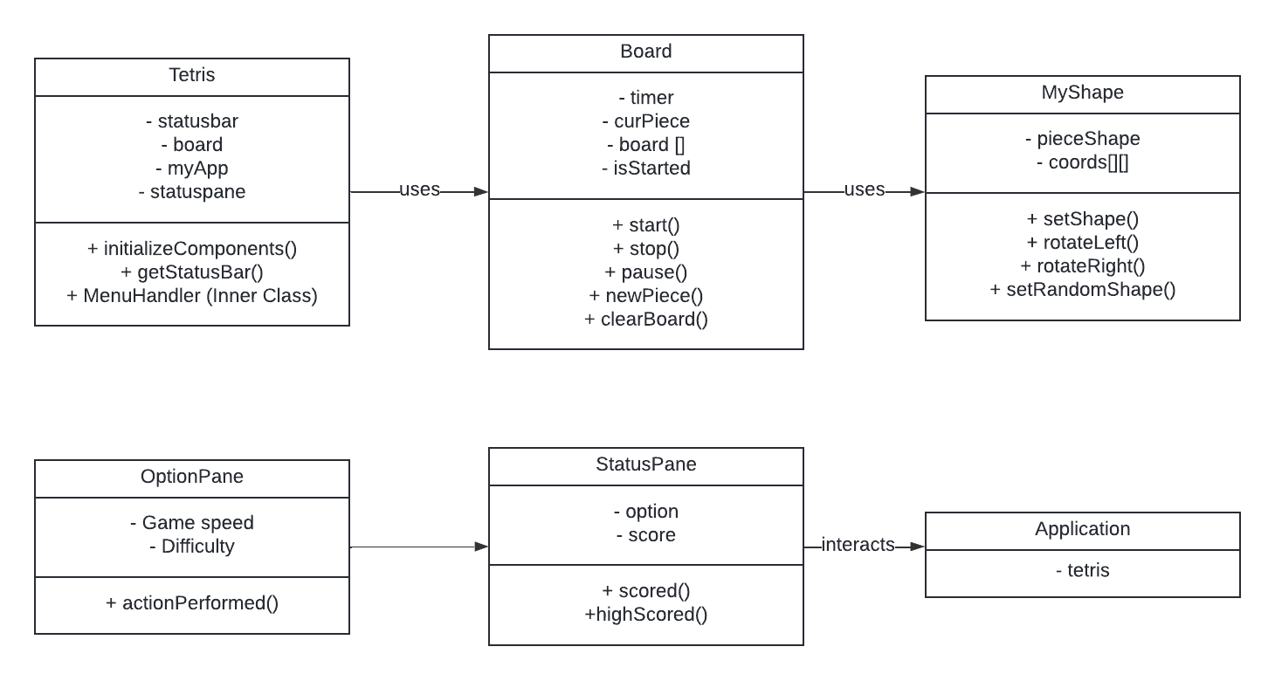
UML diagrams

Slide 7



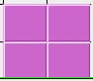



Tetris Objects
Normal level:
7 basic kinds of shapes:

Slide 8
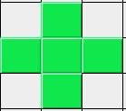
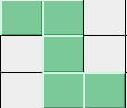


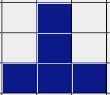

Tetris Objects
Hard level
Extreme level

Slide 9
How to play
Step 01: Click Start game to begin the new game
Step 02: Using your keyboard to operate the shapes
“S” key: Increase the shapes’ speed
“P” key: Pause the game
Space key: Drop the shapes immediately
Arrow key: Rotate the shapes to fit

Slide 10
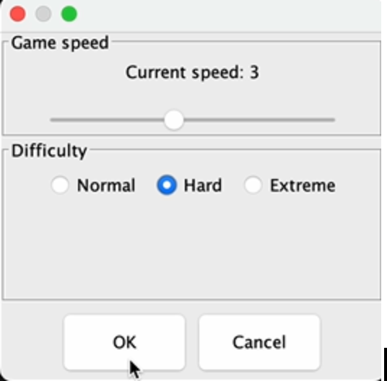
Adjust speed
Besides, you can also use the Setting to adjust the speed and difficulty, and click OK to save your choice.

Slide 11
Demo video

Slide 12
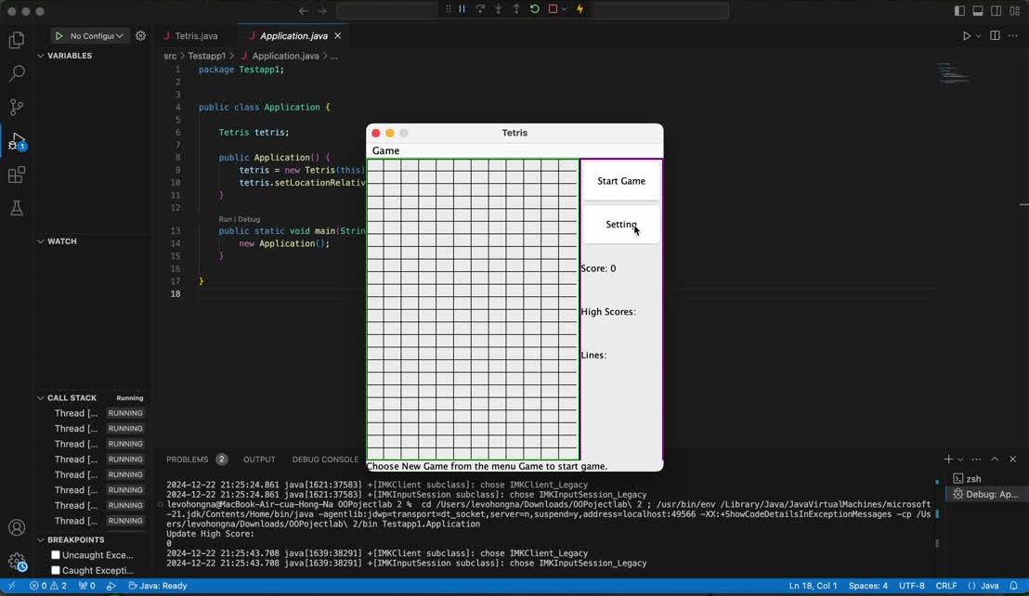

Slide 13
Thank you
for listening

